Slide 1
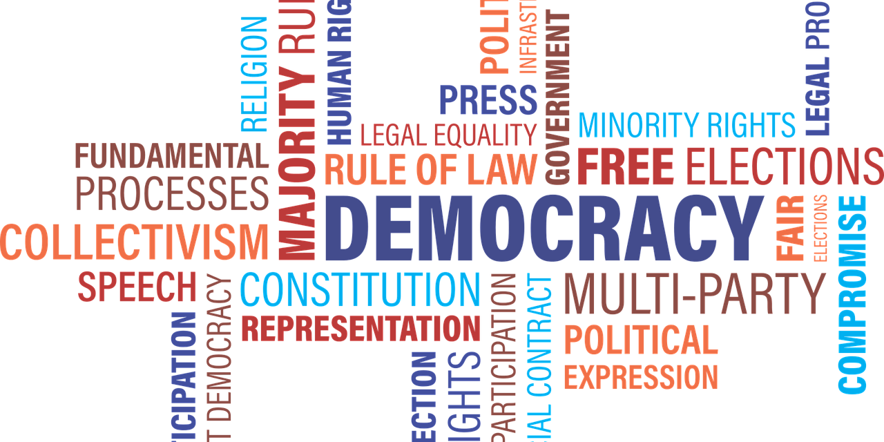

Unit – 1
Forms of Government & Constitutional Framework
Indian Constitution
DU #2301DU003
(CO-1: outline the basic values and philosophy of Indian Constitution as expressed in the Preamble.)
Prof. Deepraj K. Patadia
Civil Engineering Department
deepraj.patadia@darshan.ac.in
7990475865

Slide 2

Looping
Outline
  Government:
    Forms of Government : Monarchy, Oligarchy, Democracy, Dictatorship, Socialism
  Meaning of the Constitution
  Historical Background of the Constituent Assembly
  Government of India Act of 1935 and Indian Independence Act of 1947
  Salient features of Constitution
  National Symbols

Slide 3
Government
(Forms of Government : Monarchy, Oligarchy, Democracy, Dictatorship, Socialism)

Slide 4
Government: Definition & Types
Government: System or group of people who rule or control a country is known as a government.
The main types were,
    Monarchy
    Oligarchy
As conditions changed, so did the forms of government in different areas of the world.
By analyzing these changes and the general characteristics of past and present governments, scholars identified main forms of government as below.
    Dictatorships
    Democracies
    Socialism etc.
Some forms disappeared for a while, then emerged in other places, then transformed and returned to a previous form.

Slide 5
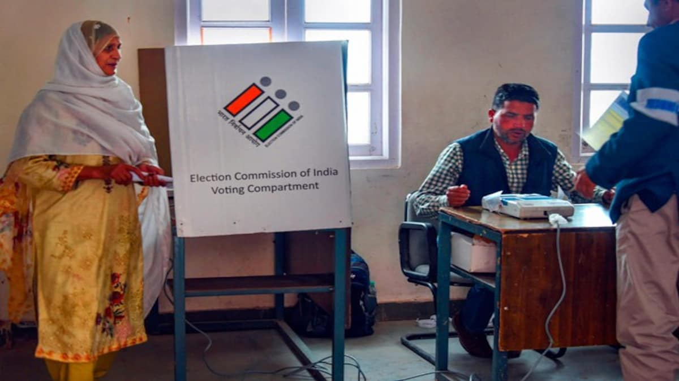
Forms of Govt. in the world
Democracy:
a system in which the government of a country is elected by the people.
  India
  Denmark
  Norway
  Sweden etc.
Laws passed by the state (ideally) reflect the will of the majority of the population.
The term democracy comes from the Greek words ‘demos’ and ‘kratos’, which mean ‘common people’ and ‘power’.
What is Democracy ???
Election by public voting

Slide 6
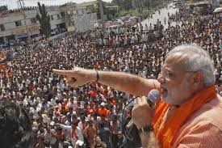


Forms of Govt. in the world
Basic rights of citizen in a democracy
01
Freedom to organize parties and hold elections
02
Freedom of speech
03
Freedom of Expression

Slide 7
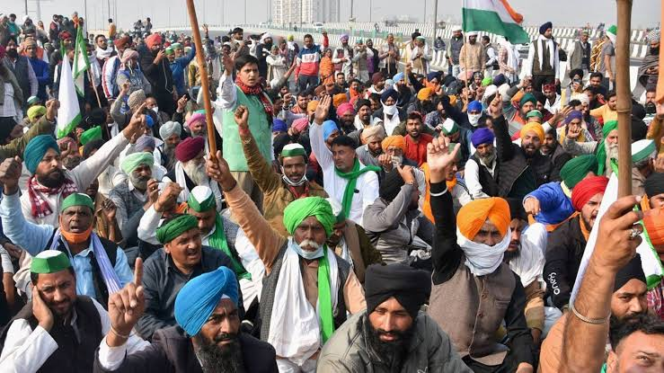


Forms of Govt. in the world
Basic rights of citizen in a democracy
  Free assembly
04
  Prohibition of unlawful imprisonment
05
  Pure and Representative Democracies
06

Slide 8
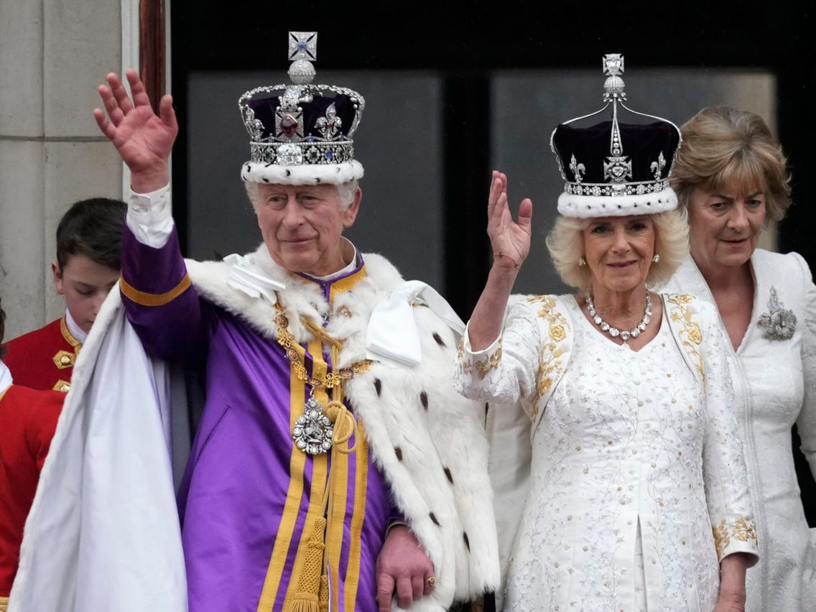
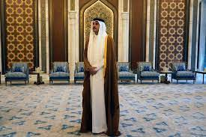
Forms of Govt. in the world
Monarchy:
A monarchy is a government where a single person (the monarch) rules the government.
  Bhutan
  UAE
  Jamaica
There are many monarchies around the world today.
The title of the monarch is hereditary; this means one inherits the position.
What is Monarchy ???
Power is hereditary

Slide 9
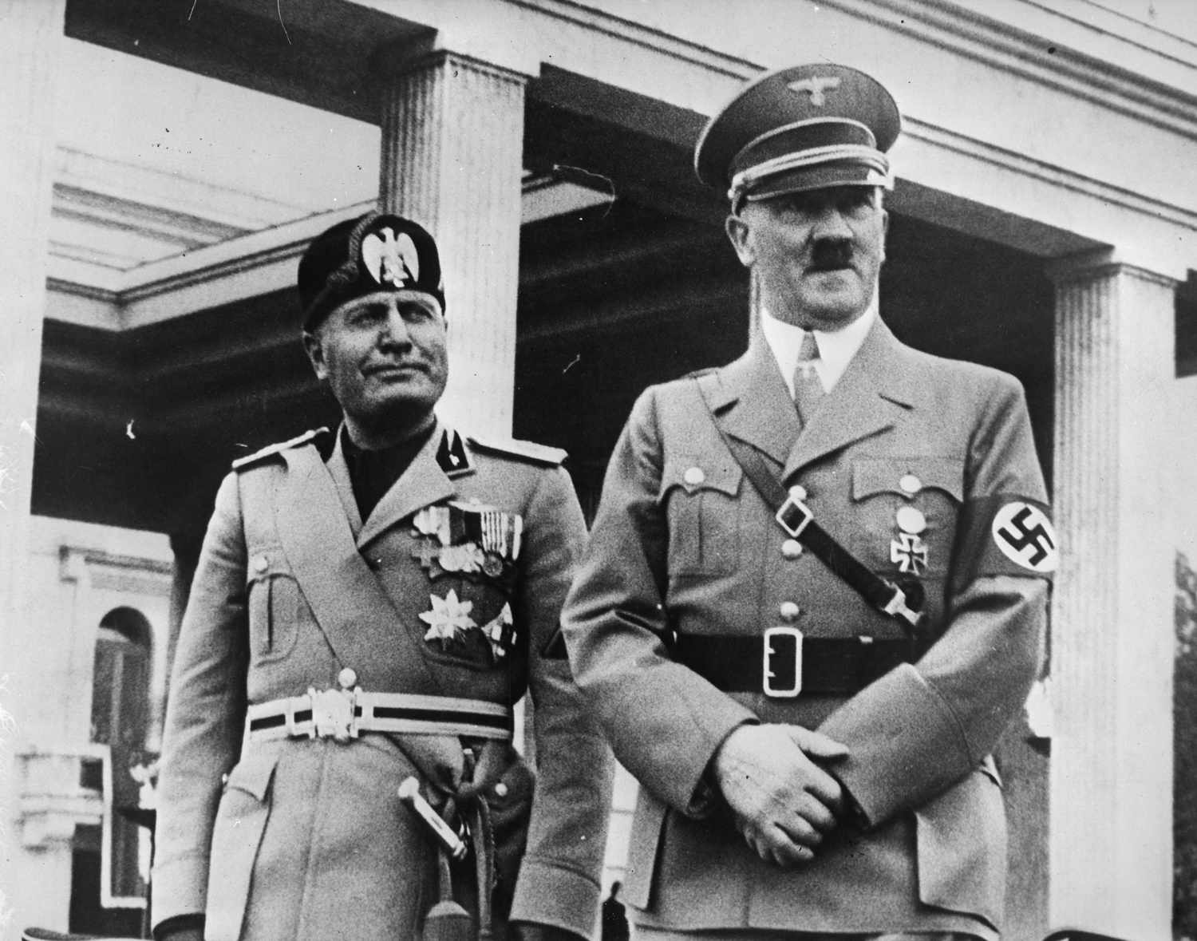

Forms of Govt. in the world
Dictatorship:
A government in which a single person or small group holds all the power, and has absolute authority over politics and the population.
  North Korea
  Eritrea
Dictatorships are often corrupt and aim to limit the liberties of the general population in order to maintain their power.
Dictators take and keep absolute power and authority through economic and military means, and they often use even brutality and threat.
What is Dictatorship ???
Rule by power/cruelty

Slide 10
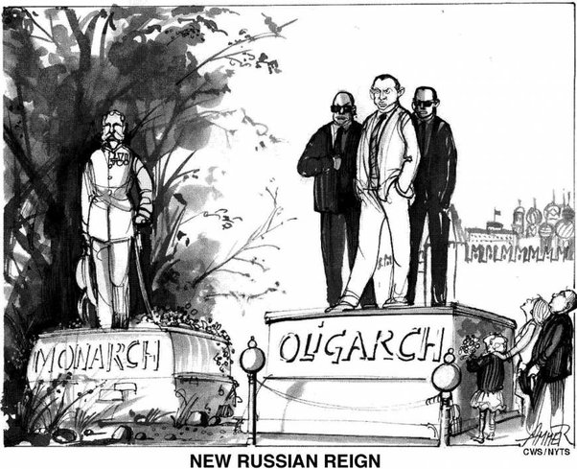

Forms of Govt. in the world
Oligarchy:
An oligarchy is a government ruled by a small, elite (સૌથી પ્રતિભાશાળી અથવા શ્રેષ્ઠ) group.
  South Africa (East Africa)
  Liberia (West Africa)
  Sultanate of Zanzibar (Arabic)
The rulers do not inherit their positions, unlike in a monarchy.
They are often influential figures from business, the military, or politics.
What is Oligarchy ???
Rule by wealthiness/power

Slide 11

Forms of Govt. in the world
Socialism:
An economic and political system promoting collective or public ownership of production.
  People’s Republic of China
  Republic of Cuba
  Republic of Vietnam
Workers share control, unlike capitalism where business owners dominate and pay wages.
What is Socialism ???
Equality, Cooperation, Public Ownership

Slide 12
Forms of Govt. in the world
Type of Government | Monarchy | Oligarchy | Dictatorship | Socialism | Democracy
Description | A system where a king, queen, or emperor rules. | A system where a small group of people rule. | A system where one person has complete control. | A system where the government or community owns resources and controls production. | A system where citizens elect representatives and have fundamental rights.
Who Holds Power | A single ruler, often hereditary (passed down in the family). | A few wealthy or powerful people or families. | A single dictator with absolute power, often gained by force. | The government or the community (in theory, the people). | Elected representatives chosen by the people.
Example | United Kingdom (constitutional monarchy), Saudi Arabia (absolute monarchy) | Ancient Sparta, Russia (sometimes considered an oligarchy) | North Korea (Kim Jong-un), Nazi Germany (Hitler) | Norway (democratic socialism), Cuba | India, United States, Germany

Slide 13
Forms of Govt. in the world
Type of Government | Monarchy | Oligarchy | Dictatorship | Socialism | Democracy
Key Points | Monarchs may have full power (absolute) or limited power (constitutional). Power usually passed within a royal family | Power is concentrated among a small elite group. Decisions often benefit the ruling group. | Limited freedoms for people. Strict control over laws, media, and people’s lives. Opposition is often suppressed. | Reduces wealth inequality, with essential services provided by the government and limited private ownership. | Free elections with protected rights like speech and assembly.

Slide 14
Forms of Govt. in the world
*
શાસન પ્રકારે | રાજાશાહી | ઓલિગાર્કી | સત્તાવાદી શાસન | સામ્યવાદ | લોકશાહી
વર્ણન | રાજા, રાણી અથવા સામ્રાટ્ દ્વારા શાસન. રાજાશાહી સંપૂર્ણ સત્તાવાળી (સંપૂર્ણ રાજાશાહી) અથવા મર્યાદિત સત્તાવાળી (સંવિધાનિક રાજાશાહી) હોઈ શકે છે. શક્તિ સામાન્ય રીતે રાજ પરિવારમાં ઉત્તરાધિકારથી પસાર થાય છે. | તે શાસન જ્યાં એક નાના સમુહ દ્વારા શાસન કરવામાં આવે છે. સત્તા મુખ્યત્વે એક નાનાં આર્થિક અથવા રાજકીય પ્રભાવશાળી સમુહ પાસે હોય છે. | એ શાસન જ્યાં એક વ્યક્તિ પાસે સંપૂર્ણ સત્તા હોય છે. નાગરિકોની મુક્તિ મર્યાદિત હોય છે અને વિરોધ દબાવી દેવામાં આવે છે. | જ્યાં સરકાર અથવા સમુદાય સંસાધનોનું માલિકત્વ અને ઉત્પાદનનું નિયંત્રણ રાખે છે. ધન સમાનતાને પ્રોત્સાહન મળે છે. | એ શાસન છે જ્યાં નાગરિકો પોતાના પ્રતિનિધિઓને ચૂંટે છે અને તેમના દ્વારા નિર્ણય લેવામાં આવે છે. નાગરિકોને મૂળભૂત અધિકારો હોય છે.
શક્તિ કોના હાથમાં છે | એક વ્યક્તિના હાથે હોય છે, જે સામાન્ય રીતે પરિવાર દ્વારા પેઢીદાર સત્તા પ્રાપ્ત કરે છે. | નાનાં આર્થિક અથવા પ્રભાવશાળી સમુહ પાસે સત્તા હોય છે. | એક તાનાશાહ, જે શક્તિ બળથી પ્રાપ્ત કરે છે. | સરકાર અથવા સમુદાય (સિદ્ધાંત પ્રમાણે લોકો). | નાગરિકો દ્વારા ચૂંટાયેલા પ્રતિનિધિઓ પાસે સત્તા હોય છે.
ઉદાહરણ | યુનાઇટેડ કિંગડમ (સંવિધાનિક રાજાશાહી), સાઉદી અરેબિયા (સંપૂર્ણ રાજાશાહી) | પ્રાચીન સ્પાર્ટા, રશિયા (ક્યારેક ઓલિગાર્કી ગણાય છે) | ઉત્તર કોરિયા (કિમ જોંગ ઉન), નાઝી જર્મની (હિટલર) | નોર્વે (પ્રજાસત્તાત્મક સામ્યવાદ), ક્યુબા | ભારત, યુનાઇટેડ સ્ટેટ્સ, જર્મની
મુખ્ય મુદ્દા | રાજાઓ પાસે સાંકેતિક ભૂમિકા કે મહત્વપૂર્ણ સત્તા હોઈ શકે છે. | નિર્ણયો સામાન્ય રીતે પ્રભાવશાળી સમુહના હિત માટે હોય છે. | નાગરિકોની અસહાયતા. કાયદા અને મીડિયા પર કડક નિયંત્રણ. | આરોગ્ય અને શિક્ષણ જેવી આવશ્યક સેવાઓ સરકાર દ્વારા આપવામાં આવે છે. ખાનગી માલિકી મર્યાદિત હોઈ શકે છે. | નાગરિકોને મુક્ત ચૂંટણીમાં ભાગ લેવા મળે છે. ભાષણ અને મિડીયા જેવા અધિકારો સુરક્ષિત હોય છે.
*for better understanding only.

Slide 15
Meaning of the Constitution

Slide 16
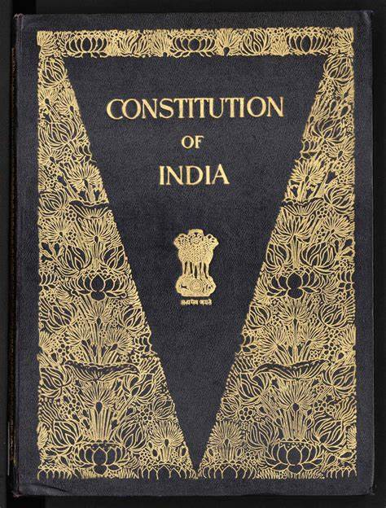
Constitution
A constitution outlines the main principles and laws of a nation or group.
It defines government powers and responsibilities.
It protects certain rights for the people.
Classification of Constitution
Type | Form | Example
Codified | In a single act (document) | Most of the world (first: United States), India
Uncodified | Fully written (in few documents) | San Marino, Israel, Saudi Arabia
Partially Unwritten | See constitutional convention | Canada, New Zealand, United Kingdom

Slide 17
Constitution
India’s Constitution is the supreme law of India.
It defines the Government’s fundamental political values, policies, processes, powers, rights, and duties.
It reflects constitutional, not parliamentary supremacy, being established by a constituent assembly and adopted by citizens.
The Constitution of India is the longest Constitution in the world.
It had…
  395 articles
  22 parts
  8 schedules
  1,46,385 words (in Hindi version) at its beginning.
It currently has a preamble, 25 parts with 12 schedules, 5 appendices, 470 articles & 105 amendments.

Slide 18
History of Indian Constitution
India’s Constitution was adopted in the year 1949 on November 26.
It came into effect on January 26, 1950. January 26 is celebrated as Republic Day of India and the assembly approved it.
The Chairman of the drafting committee, Dr. B. R. Ambedkar, is generally regarded as the architect of the Indian Constitution.
  Other committee members were: K.M. Munshi, Muhammed Saadulah, Alladi Krishnaswamy Iyer, Gopal Swami Ayyangar, N. Madhava Rao, T.T. Krishnamachari.
The Preamble of the Constitution of India got inspiration from the Constitution and preamble of the USA.
Prem Bihari Narain Raizada wrote the actual copies of the Indian Constitution.
283 members signed the original Indian Constitution.

Slide 19
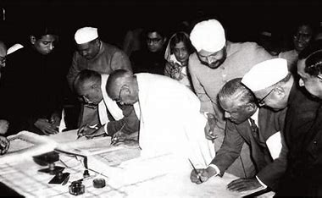
Facts of Indian Constitution
Members of Constituent Assembly signing the final copy of Constitution

Slide 20
Facts of Indian Constitution
Originally, the Indian Constitution was written in Hindi and English.
The English variety of the Constitution of India has 1,17,369 words.
Various artists who hailed from Shantiniketan (West Bengal) had decorated the pages of the Indian Constitution.
On 9th December 1946, the first meeting of the Constituent Assembly took place.
Nearly 2000 amendments were made in the initial draft of the Indian Constitution.
On 24th January 1950, the Indian Constitution was signed.
On 26th January 1950, the Indian Constitution was enforced legally.
In the year 2019, there were 103 amendments that were made in the Indian Constitution since the time it was enforced.

Slide 21
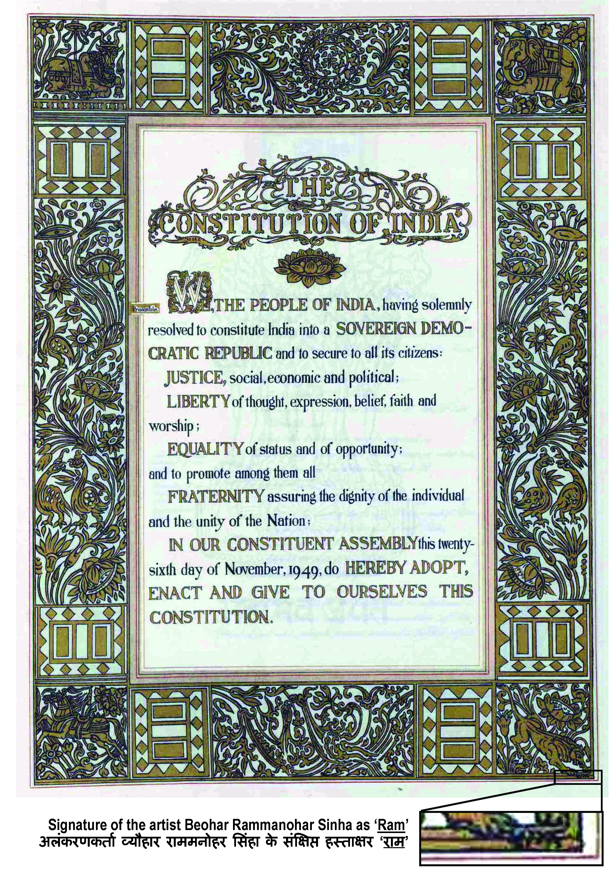
Facts of Indian Constitution

Slide 22
Historical Background of the Constituent Assembly

Slide 23
Historical Background of the Constituent Assembly
Formation of Constituent Assembly
In 1934, M N Roy first proposed the idea of a constituent assembly.
The demand was taken up by the Congress Party in 1935 as an official demand.
The British accepted this in the August Offer of 1940.
  The August Offer promised future constitutional reforms and minority safeguards but no immediate self-rule, so it was rejected by Indian leaders.
Under the Cabinet Mission plan of 1946, elections were held for the formation of the constituent assembly.
The constituent assembly was formed for the purpose of writing a constitution for independent India.
The last session was held during 14 – 26 November 1949.

Slide 24
Historical Background of the Constituent Assembly
Development after August Offer
Year | Event / Proposal | Key Person / Body | Main Provisions | Outcome
1940–41 | Individual Satyagraha | Mahatma Gandhi | Limited protest against forced war participation | Many leaders arrested
1942 | Cripps Mission | Stafford Cripps | Dominion status after war, Constituent Assembly | Rejected by Congress & Muslim League
1942 | Quit India Movement | Indian National Congress | Immediate British withdrawal | Suppressed; leaders jailed
1945 | Wavell Plan | Lord Wavell | Reconstitution of Executive Council | Failed due to political deadlock
1945 | Simla Conference | British Govt. | Discussion on Wavell Plan | No agreement
1946 | Cabinet Mission Plan | British Cabinet | Constituent Assembly, federal structure | Accepted with reservations
1946–49 | Constituent Assembly | Indian Leaders | Drafting of Constitution | Constitution prepared
1950 | Constitution in Force | Republic of India | Democratic Constitution | Constitution adopted

Slide 25
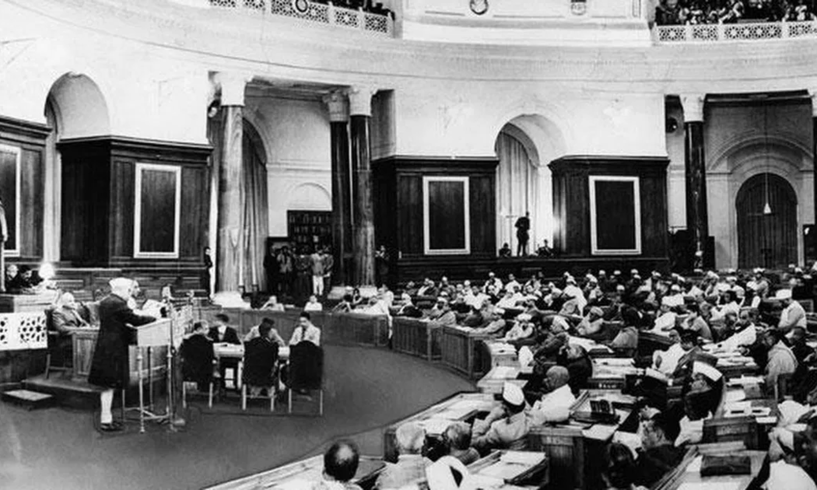
Constituent Assembly

Slide 26
Government of India Act of 1935 and
Indian Independence Act of 1947

Slide 27
Government of India Act 1935
Government of India Act 1935 made India a Federal Country and was a milestone in governance.
British arrived in the 1600s for trade; East India Company got rights from Queen Elizabeth I.
East India Company ruled 200 years before Independence in 1947.
Independence led to a constitution ensuring justice for the common man.
The 1935 Act introduced a responsible government.
It was the last British constitution before Independence.
It gave women a separate electorate and more power.
It paved the way for Independence and the constitution.

Slide 28
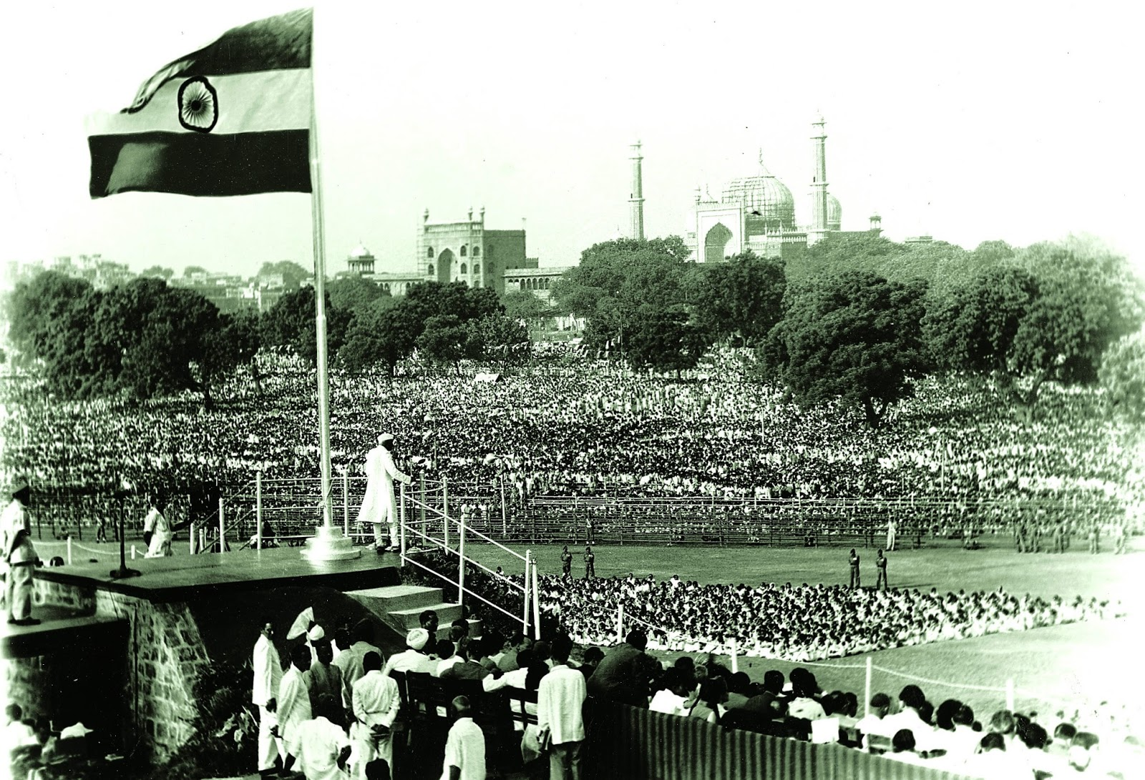
Indian Independence Act of 1947
The Indian Independence Act, passed by the UK Parliament on July 18, 1947, established independent India and Pakistan.
The Indian Independence Act was set to take effect on August 15, 1947, just a month after being passed.

Slide 29
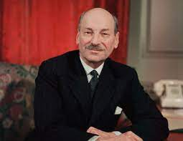
Indian Independence Act of 1947
Attlee's Announcement
Clement Attlee, the Prime Minister of the United Kingdom, announced on 20 February 1947 that:
  The British Government would grant full self-government to British India by 30 June 1948 at the latest.
  The future of the Princely States (રજવાડાઓ) would be decided after the date of final transfer is decided.

Slide 30
Indian Independence Act of 1947
June Plan
The 3 June 1947 Plan was also known as the Mountbatten Plan, that included these principles:
    Principle of the partition of British India was accepted by the British Government
    Successor governments would be given dominion status
    Autonomy and sovereignty to both countries
    Can make their own constitution
    Princely States were given the right to join either Pakistan or India, based on two major factors: Geographical contiguity and the people's wishes

Slide 31
Salient features of Constitution

Slide 32






Salient Features of Indian Constitution
Constitution of India – Major Features
Irish
British
Canadian
USA
South Africa
Australia

Slide 33
Details on Indian Constitution
Topic | Details
Adoption Date | 26th November 1949
Effective Date | 26th January 1950
Drafting Body | Constituent Assembly
Chairman of Drafting Committee | Dr. B.R. Ambedkar
Key Contributors | Dr. B.R. Ambedkar, Dr. Rajendra Prasad, Jawaharlal Nehru, Sardar Vallabhbhai Patel, Alladi Krishnaswamy Iyer, K.M. Munshi, B.N. Rau (Constitutional Advisor), and H.C. Mookerjee
Total Articles | 395 articles at adoption (currently around 470)
Schedules | 8 schedules at adoption (currently 12)
Parts | 25 parts
Language | Written in English and Hindi
Longest Written Constitution | Yes, it’s the longest written constitution in the world
Fundamental Rights | 6 fundamental rights guaranteed to all citizens
Directive Principles | Guidelines for government to create a fair society
Amendments | 105 amendments as of 2023
Unique Feature | Mix of principles from British, American, Irish, and other constitutions
Federal Structure | Union of states with power divided between the center and states

Slide 34
Constitution of India – Major Features
1
Written Constitution
Adopted on November 26, 1949
448 Articles, 12 Schedule, 5 Appendices and 1.46 Lakh words (Source: Livemint as per 25th Jan 2023.)
2
Lengthy Constitution:
3
Federal System
Power is divided between the central government and the states.
President is the nominal head of state, and the Prime Minister is the head of government
4
Parliamentary Form of Government
Fundamental Rights
Right to equality, right to freedom, right against exploitation, right to freedom of religion, cultural and educational rights etc.
5
34

Slide 35
Constitution of India – Major Features
Article 39A directs the state to ensure equal justice and provide free legal aid to the poor and weaker sections of society.
6
Directive Principles of State Policy
7
Independent judiciary as a guardian of the fundamental rights
Independent Judiciary
8
Secularism
Treats all religions equally
Age of 18 has the right to vote without any discrimination
9
Universal Adult Suffrage
A citizen of the country as a whole and not of any particular state..
10
Single Citizenship:
35

Slide 36
Constitution of India – Major Features
11
Reservation Policy
Promote social inclusion and upliftment of marginalized communities.
12
Role in interpreting and safeguarding the Constitution and fundamental rights
Judicial Activism
Amendments to fundamental rights require a special majority, while amendments to certain other provisions may require a simple majority.
13
Rigidity and Flexibility
14
Election Commission, Comptroller and Auditor General
Independent Bodies
safeguards the cultural and educational rights of diverse communities and minorities
15
Protection of Cultural and Educational Rights
36

Slide 37
National Symbols

Slide 38
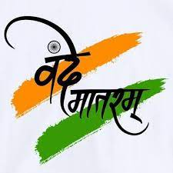
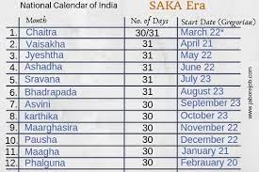
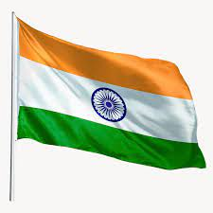
National Symbols of India
National Symbols of India:
National symbols reflect India's heritage, pride, and cultural identity.
They hold significant national importance for the country.
Every citizen should be aware of these national symbols.
Vande Mataram
Tri-colour of
saffron, white, and green
Shaka Calender/Vikram Savant
National Song
National Calendar
National Flag

Slide 39


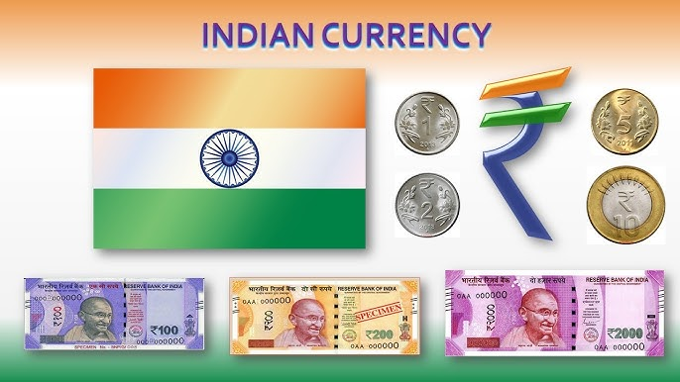
National Symbols of India
Bengal Tiger
Peacock
Indian Rupee
National Animal
National Bird
National Currency

Slide 40


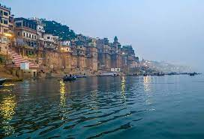
National Symbols of India
Ganges River Dolphin
Mango
The Ganga River
National Aquatic Animal
National Fruit
National River

Slide 41

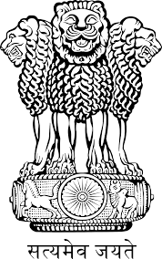
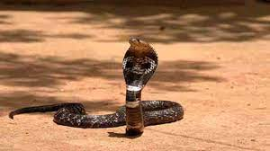
National Symbols of India
Lotus
Lion Capital of Ashoka (અશોક મૌર્યનું સારનાથ સ્તંભશીર્ષ)
King Kobra
National Flower
National Emblem
National Reptile
41

Slide 42



National Symbols of India
Hockey
Banyan Tree (વડ)
Elephant
National Game
National Tree
National Heritage Animal
42
42

Slide 43
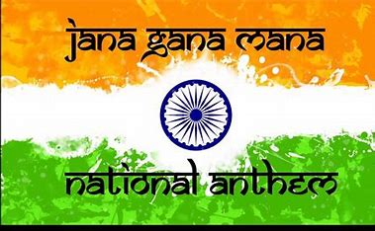
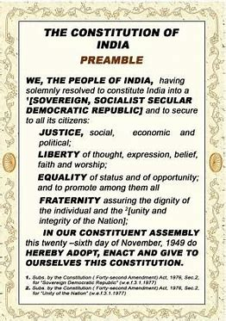
National Symbols of India
Jana Gana Mana
Oath in Preamble
National Anthem
National Oath
43

Slide 44
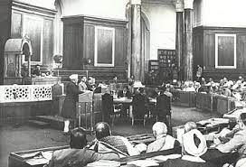
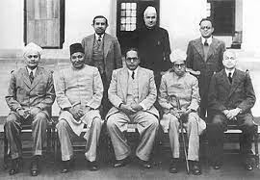
Pictures of Constituent Assembly
44

Slide 45
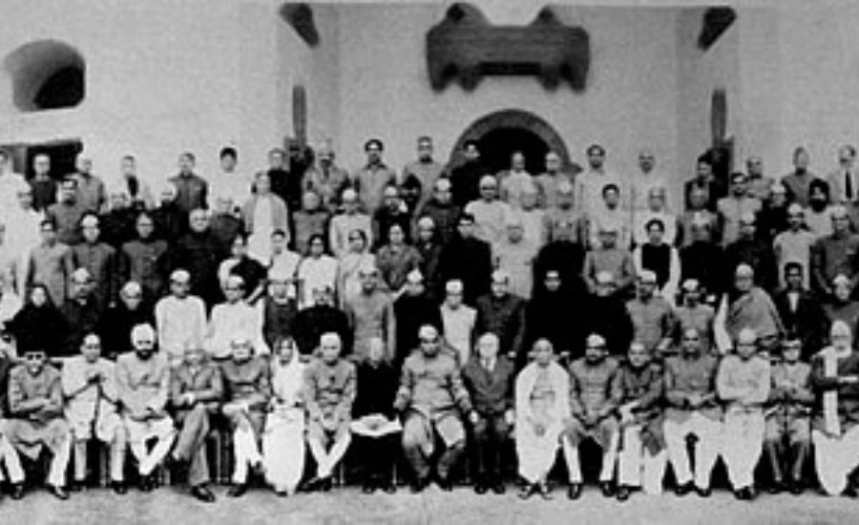
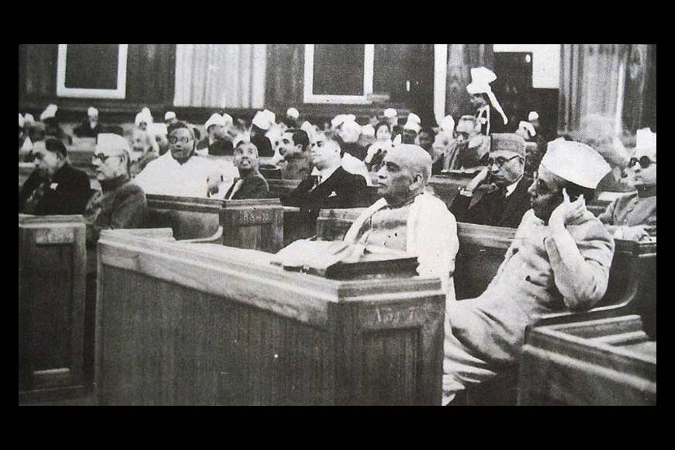
Pictures of Constituent Assembly
45

Slide 46
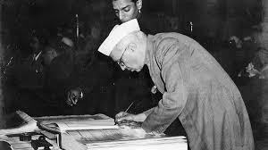
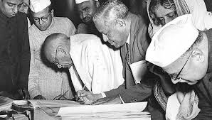
Pictures of Constituent Assembly
46

Slide 47
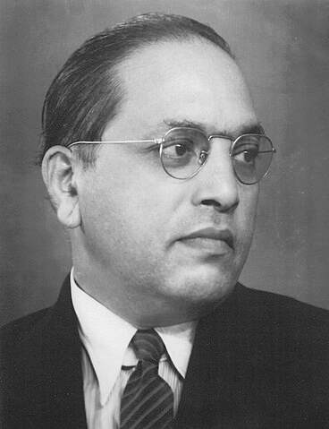
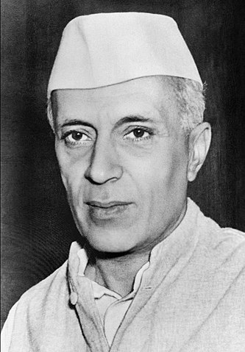
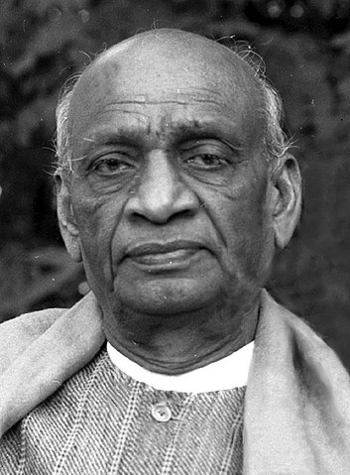
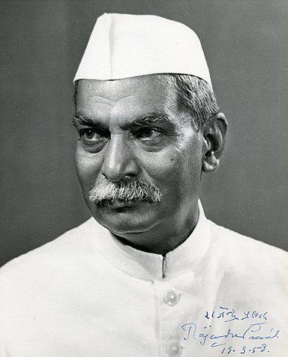
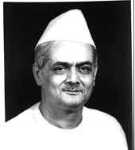
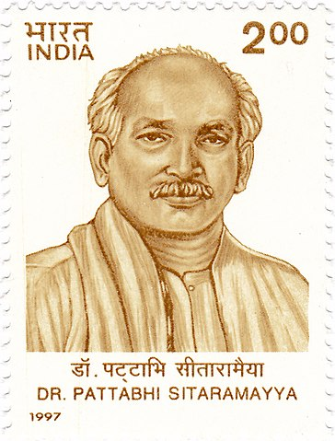
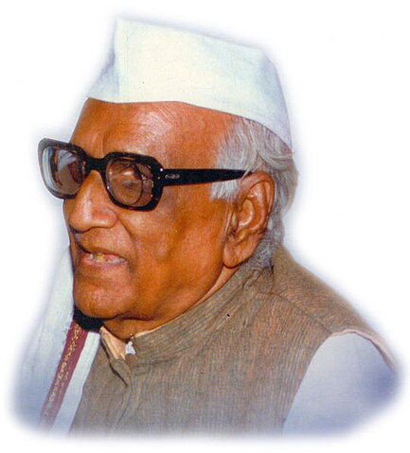
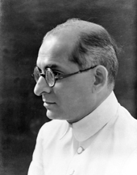
People who contributed for Indian Constitution
Dr. Bhimrao Ambedkar
Jawaharlal Nehru
Sardar Vallabhbhai Patel
Dr. Rajendra Prasad
G.V. Mavlankar
…..& many known – unknown personalities
B. Pattabhi Sitaramayya
Moturi Satyanarayana
K.M. Munshi
47

Slide 48
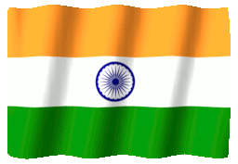
Thank You
Indian Constitution
DU #2301DU003
I like the religion that teaches
Liberty, Equality & Fraternity“
-Dr. B.R. Ambedkar

